Slide 1
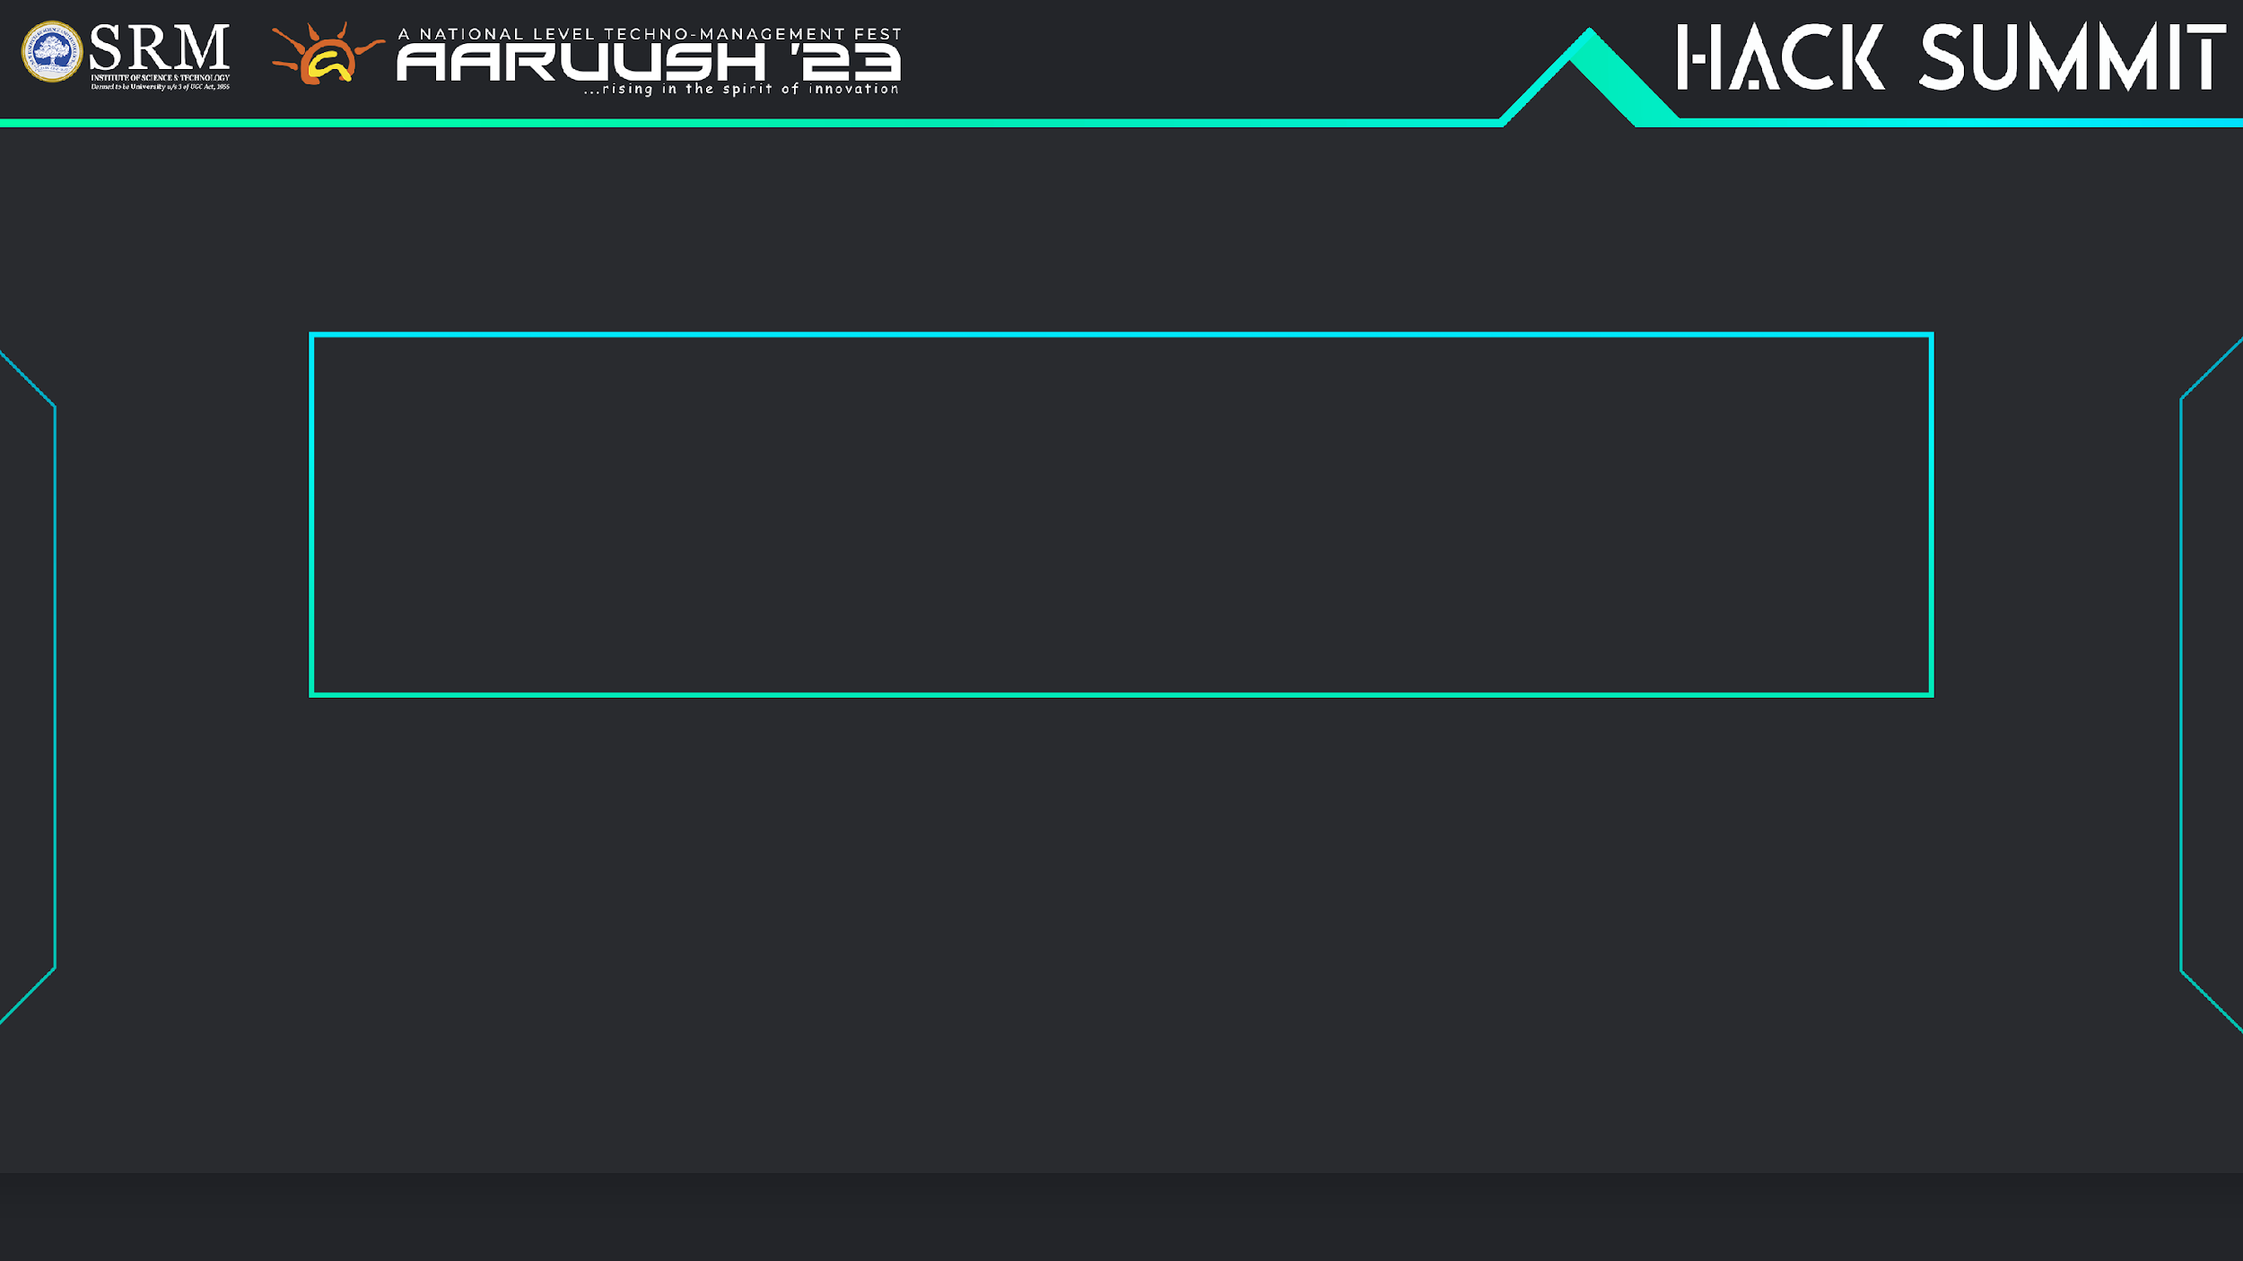


Team Members :
1. Abdullah Firdowsi M F
2. Baby Shalini Priya C
3. Roja K
4. Viswanath S R
5. Vishnuvaradhan V

Slide 2
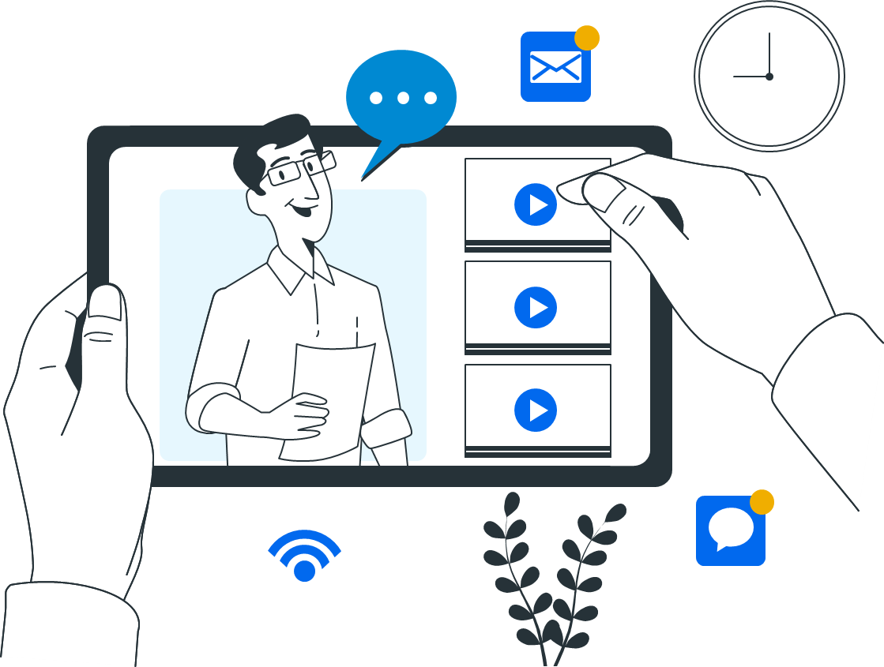
PROBLEM STATEMENT:
Traditional chatbots are capable of producing
text based output.
Documents that are complex to understand
needs expert assistance which is not feasible
Exploring the web to clear your doubts
Spending hours in comprehending long
documents (legal, product documentation,etc..)

Slide 3
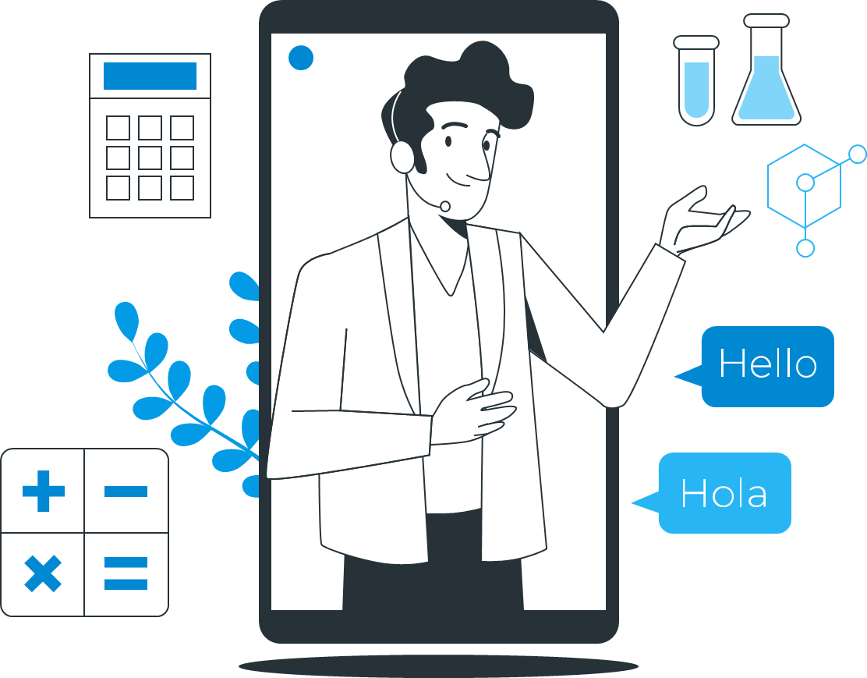
PROPOSED SOLUTION:
Intelligent bot to explain complex
Documents.
Virtual assistant for interactive user
experience.
Real time access to internet for
handling comprehensive questions.
A light weight model to support
multiple hardware platforms.

Slide 4
TECH STACK:
Streamlit: To create the user interface for the application and serves as the core framework for building web applications with Python.
Python: The entire code provided is written in Python.
PDF Processing: Processing PDF files using the PyPDF Loader and Document classes from the Langchain library.
LLM: To provide a comprehensive summary of the entire document, condensing its content into a concise form for easier understanding and reference.
OPEN CV :To generate visualizations, leveraging its powerful computer vision and image processing capabilities for creating graphical representations.
GTTS: It is a Python library that converts text input into natural-sounding voice audio, offering an easy way to add speech synthesis to applications, scripts, or projects, making content accessible and interactive.

Slide 5
EVALUATING THE MODEL:
Summarization Metrics:
Automated metrics like ROUGE and BLEU consistently yield high scores, indicating that the model's generated summaries closely align with reference texts.
Question Answering Metrics:
Precision, recall, F1-score, and accuracy metrics consistently show excellent performance, reflecting the model's ability to provide accurate answers across a wide range of questions.
Scalability:
The model demonstrates robust scalability, accommodating a growing number of users and requests without compromising performance. It remains responsive under various load conditions.
Resource Usage:
The model's resource usage remains within acceptable limits, demonstrating efficiency in terms of CPU and memory utilization
Data Quality and Preprocessing:
Data quality is excellent, and the preprocessing steps effectively prepare the input data for the model, resulting in consistently accurate outputs.

Slide 6
FUTURE WORK:
Language Support:
Extend language support to accommodate a broader range of languages, making the application accessible to a global audience.
Document Format Support:
Enhance the application's ability to handle various document formats beyond PDF, such as Word, HTML, and plain text.
Collaboration and Sharing:
Add collaboration features, allowing users to share summarized documents or QA sessions with others. Implement real-time collaboration for document editing and discussion.
Customization and APIs:
Allow organizations to customize the application to suit their specific needs and branding. Provide APIs for developers to integrate the application's capabilities into other software products.
Integration with VR:
To make it feel more realistic and add a sense of immersion to the experience.

